Slide 1
Covariance
Covariance
Definition
Relationship with Independence
Detour: Standardizing Random Variables
Property of Covariance, Correlation
Conditional Expectation
Lecture 21, CS70 Fall 2025

Slide 2

Covariance
Last time, we showed that:
If $X$ and $Y$ are independent, then these blue terms cancel out.
If $X$ and $Y$ are not independent, the variance of the sum will depend on this term.
This term (excluding the factor of 2) is called the covariance.
$$Var\left(X+Y\right)=𝔼\left[{\left(X+Y\right)}^{2}\right]−{\left(𝔼\left[X+Y\right]\right)}^{2}$$
$$=Var(X)+2𝔼\left[XY\right]−2𝔼\left[X\right]𝔼\left[Y\right]+Var(Y)$$

Slide 3
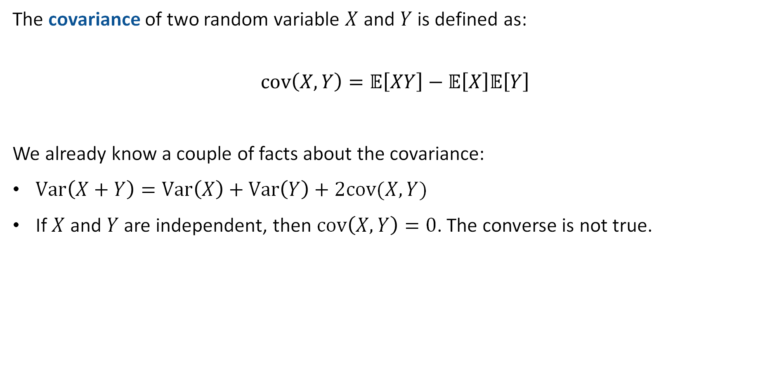
Covariance Definition
The covariance of two random variable $X$ and $Y$ is defined as:
$$cov\left(X, Y\right)=𝔼\left[XY\right]−𝔼\left[X\right]𝔼\left[Y\right]$$
We already know a couple of facts about the covariance:
$Var\left(X+Y\right)=Var\left(X\right)+Var\left(Y\right)+2cov(X,Y)$
If $X$ and $Y$ are independent, then $cov\left(X,Y\right)=0$. The converse is not true.

Slide 4

Covariance Intuitively
Suppose we have a normal playing card deck. Let $R_{1}$ be 1 if the first draw is a red card (♥ or ♦), let $B_{2}$ be 1 if the second draw is a black card (♠ or ♣).
The covariance is given by $cov\left(R_{1}, B_{2}\right)=𝔼\left[R_{1}B_{2}\right]−𝔼\left[R_{1}\right]𝔼\left[B_{2}\right]$
$𝔼\left[R_{1}\right]=1/2$
$𝔼\left[B_{2}\right]=1/2$
Then we have:
$𝔼\left[R_{1}B_{2}\right]=0×0×P\left(R_{1}=0,B_{2}=0\right)+$
$$0×1×P\left(R_{1}=0,B_{2}=1\right)+$$
$$1×0×P\left(R_{1}=1,B_{2}=0\right)+$$
$$1×1×P\left(R_{1}=1,B_{2}=1\right)$$
Note: As we’ve seen before, the $𝔼$ of the product of two indicator variables is just the probability they are both true.

Slide 5






Covariance Intuitively
Suppose we have a normal playing card deck. Let $R_{1}$ be 1 if the first draw is a red card (♥ or ♦), let $B_{2}$ be 1 if the second draw is a black card (♠ or ♣).
The covariance is given by $cov\left(R_{1}, B_{2}\right)=𝔼\left[R_{1}B_{2}\right]−𝔼\left[R_{1}\right]𝔼\left[B_{2}\right]$
$𝔼\left[R_{1}\right]=1/2$
$𝔼\left[B_{2}\right]=1/2$
Then we have:
$𝔼\left[R_{1}B_{2}\right]=P\left(R_{1}=1,B_{2}=1\right)$
$$P\left(R_{1}=1,B_{2}=1\right)=$$
$$P\left(B_{2}=1|R_{1}=1\right)×$$
$$P\left(R_{1}=1\right)$$
$$=26/51×26/52$$
$$=13/51$$

Slide 6

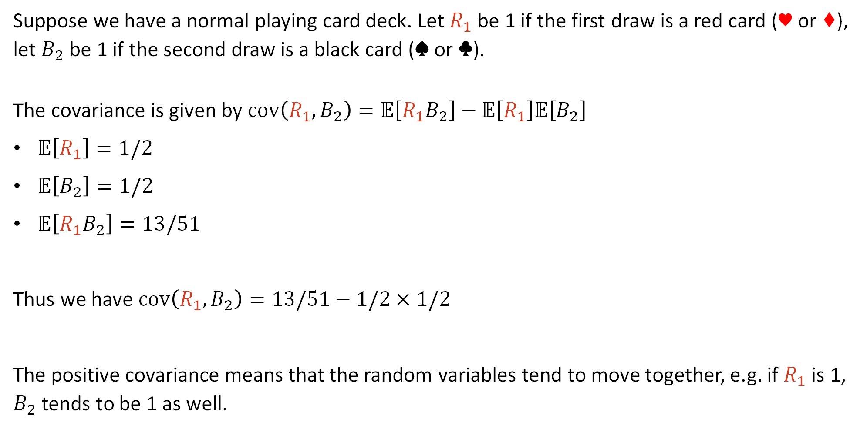
Covariance Intuitively
Suppose we have a normal playing card deck. Let $R_{1}$ be 1 if the first draw is a red card (♥ or ♦), let $B_{2}$ be 1 if the second draw is a black card (♠ or ♣).
The covariance is given by $cov\left(R_{1}, B_{2}\right)=𝔼\left[R_{1}B_{2}\right]−𝔼\left[R_{1}\right]𝔼\left[B_{2}\right]$
$𝔼\left[R_{1}\right]=1/2$
$𝔼\left[B_{2}\right]=1/2$
$𝔼\left[R_{1}B_{2}\right]=13/51$
Thus we have $cov\left(R_{1}, B_{2}\right)=13/51−1/2×1/2$
The positive covariance means that the random variables tend to move together, e.g. if $R_{1}$ is 1, $B_{2}$ tends to be 1 as well.
$$≈0.0049$$

Slide 7
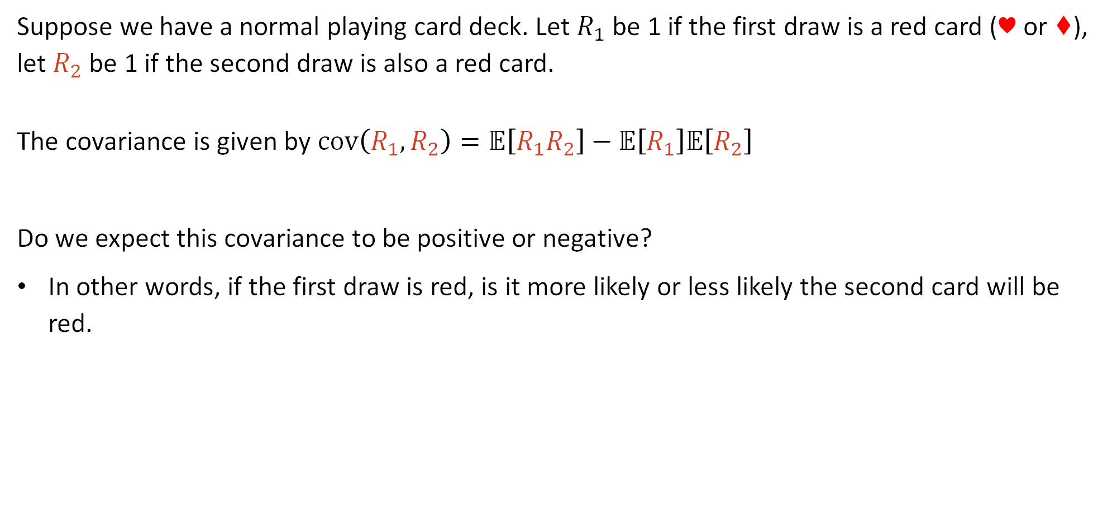
Covariance Intuitively (Example 2)
Suppose we have a normal playing card deck. Let $R_{1}$ be 1 if the first draw is a red card (♥ or ♦), let $R_{2}$ be 1 if the second draw is also a red card.
The covariance is given by $cov\left(R_{1}, R_{2}\right)=𝔼\left[R_{1}R_{2}\right]−𝔼\left[R_{1}\right]𝔼\left[R_{2}\right]$
Do we expect this covariance to be positive or negative?
In other words, if the first draw is red, is it more likely or less likely the second card will be red.

Slide 8

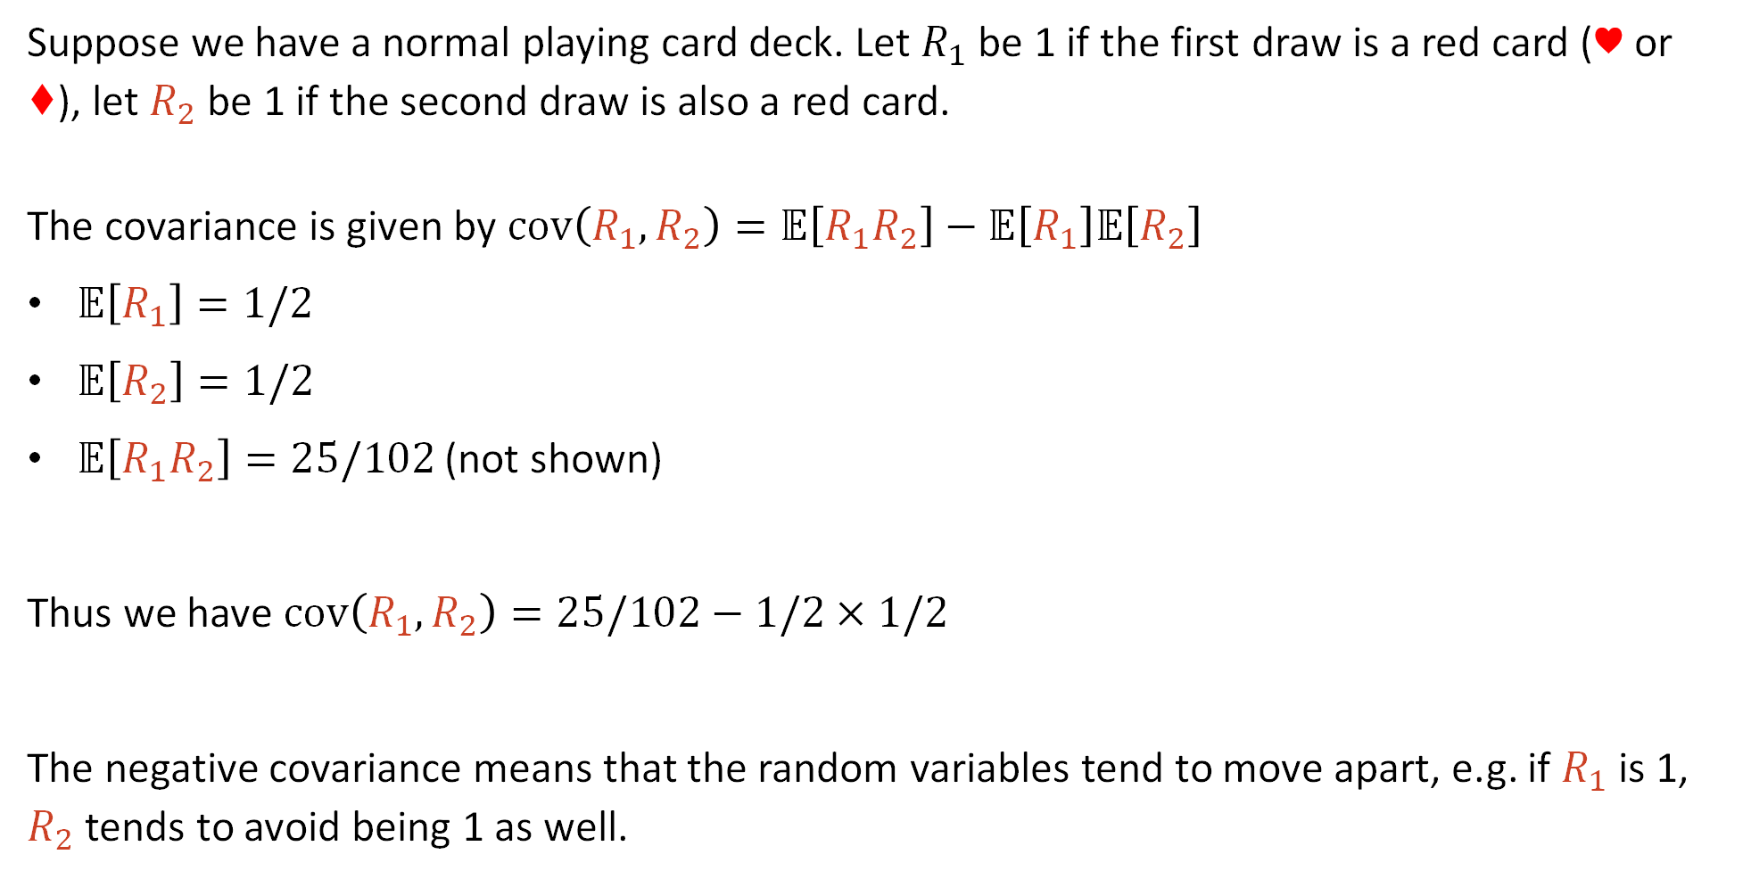
Covariance Intuitively (Example 2)
Suppose we have a normal playing card deck. Let $R_{1}$ be 1 if the first draw is a red card (♥ or ♦), let $R_{2}$ be 1 if the second draw is also a red card.
The covariance is given by $cov\left(R_{1}, R_{2}\right)=𝔼\left[R_{1}R_{2}\right]−𝔼\left[R_{1}\right]𝔼\left[R_{2}\right]$
$𝔼\left[R_{1}\right]=1/2$
$𝔼\left[R_{2}\right]=1/2$
$𝔼\left[R_{1}R_{2}\right]=25/102$ (not shown)
Thus we have $cov\left(R_{1},R_{2}\right)=25/102−1/2×1/2$
The negative covariance means that the random variables tend to move apart, e.g. if $R_{1}$ is 1, $R_{2}$ tends to avoid being 1 as well.
$$≈−0.0049$$

Slide 9
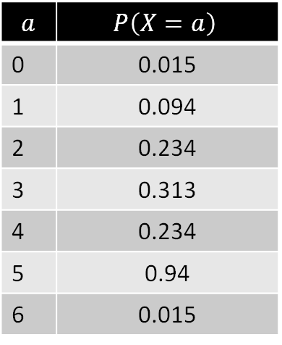

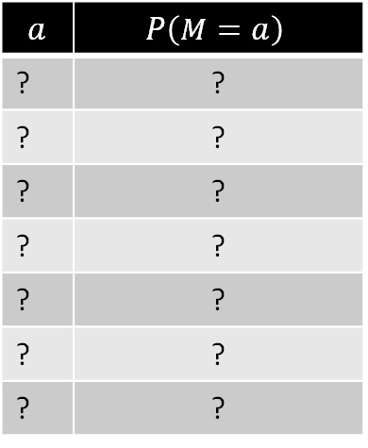

Random Variables and Sampled Data
Let $M$ be the midterm score of a student in CS70, Fall 2025.
Observation: $M$ is a random variable. It’s just as real as the Bernoulli, Binomial, Geometric, etc. distributions.
What would $M$ look like? What are the values for $a$? $P\left(M=a\right)$?
$$a$$ | $$P\left(X=a\right)$$
0 | 0.015
1 | 0.094
2 | 0.234
3 | 0.313
4 | 0.234
5 | 0.94
6 | 0.015
$$a$$ | $$P\left(M=a\right)$$
? | ?
? | ?
? | ?
? | ?
? | ?
? | ?
? | ?
Distribution for $X\sim Binomial(6, 0.5)$

Slide 10

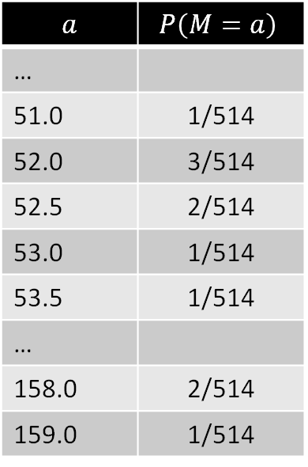
Random Variables and Sampled Data
Let $M$ be the midterm score of a student in CS70, Fall 2025.
Observation: $M$ is a random variable. It’s just as real as the Bernoulli, Binomial, Geometric, etc. distributions.
What would $M$ look like? What are the values for $a$? $P\left(M=a\right)$?
  range($M$): Set of scores on the midterm.
  $P\left(M=a\right)$: Fraction of students with that score.
$$a$$ | $$P\left(M=a\right)$$
…
51.0 | 1/514
52.0 | 3/514
52.5 | 2/514
53.0 | 1/514
53.5 | 1/514
…
158.0 | 2/514
159.0 | 1/514
$$a$$ | $$P\left(X=a\right)$$
0 | 0.015
1 | 0.094
2 | 0.234
3 | 0.313
4 | 0.234
5 | 0.94
6 | 0.015
Distribution for $X\sim Binomial(6, 0.5)$

Slide 11


Random Variables and Sampled Data
Let $M$ be the midterm score of a student in CS70, Fall 2025.
What would $M$ look like? What are the values for $a$? $P\left(M=a\right)$?
  range($M$): Set of scores on the midterm.
  $P\left(M=a\right)$: Fraction of students with that score.
What is the sample space $Ω$?
$$a$$ | $$P\left(M=a\right)$$
…
51.0 | 1/514
52.0 | 3/514
52.5 | 2/514
53.0 | 1/514
53.5 | 1/514
…
158.0 | 2/514
159.0 | 1/514
https://joshh.ug/A
$$a$$ | $$P\left(X=a\right)$$
0 | 0.015
1 | 0.094
2 | 0.234
3 | 0.313
4 | 0.234
5 | 0.94
6 | 0.015
Distribution for $X\sim Binomial(6, 0.5)$

Slide 12



Random Variables and Sampled Data
Let $M$ be the midterm score of a student in CS70, Fall 2025.
What would $M$ look like? What are the values for $a$? $P\left(M=a\right)$?
  range($M$): Set of scores on the midterm.
  $P\left(M=a\right)$: Fraction of students with that score.
What is the sample space $Ω$?
  The set of all 514 students in CS70.
$$a$$ | $$P\left(M=a\right)$$
…
51.0 | 1/514
52.0 | 3/514
52.5 | 2/514
53.0 | 1/514
53.5 | 1/514
…
158.0 | 2/514
159.0 | 1/514
Aleš Balqis
Eskender Yann
Yawen Jin
…
Terence Tao
Roshan Sunitha
Francisco Kali
$$M\left(ω\right)$$
$$Ω=$$
For privacy reasons, I’ve made up 514 new names.

Slide 13




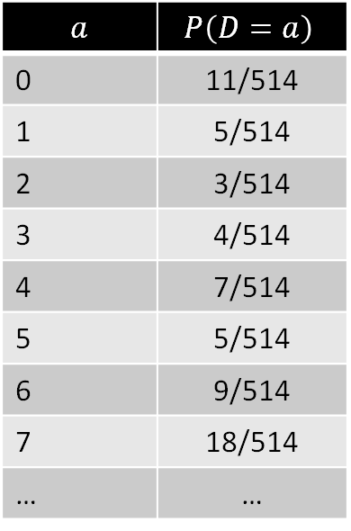
Random Variables and Sampled Data
Let $D$ be the discussion attendance score of a CS 70, Fall 2025 student.
Suppose we want to compute the covariance of $D$ and $M$.
What does it mean if these RVs have positive covariance?
$$a$$ | $$P\left(D=a\right)$$
0 | 11/514
1 | 5/514
2 | 3/514
3 | 4/514
4 | 7/514
5 | 5/514
6 | 9/514
7 | 18/514
… | …
$$a$$ | $$P\left(M=a\right)$$
…
51.0 | 1/514
52.0 | 3/514
52.5 | 2/514
53.0 | 1/514
53.5 | 1/514
…
158.0 | 2/514
159.0 | 1/514
$ω=$Terence Tao
$$D\left(ω\right)$$
$$M\left(ω\right)$$

Slide 14

Random Variables and Sampled Data
Let $D$ be the discussion attendance score of a CS 70, Fall 2025 student.
Suppose we want to compute the covariance of $D$ and $M$.
What does it mean if these RVs have positive covariance? Students who go to discussion tend to also do better on exams. Note: No causality established!
$$a$$ | $$P\left(D=a\right)$$
0 | 11/514
1 | 5/514
2 | 3/514
3 | 4/514
4 | 7/514
5 | 5/514
6 | 9/514
7 | 18/514
… | …
$$a$$ | $$P\left(M=a\right)$$
…
51.0 | 1/514
52.0 | 3/514
52.5 | 2/514
53.0 | 1/514
53.5 | 1/514
…
158.0 | 2/514
159.0 | 1/514
$ω=$Terence Tao
$$D\left(ω\right)$$
$$M\left(ω\right)$$

Slide 15

Random Variables and Sampled Data
Let $D$ be the discussion attendance score of a CS 70, Fall 2025 student.
Suppose we want to compute the covariance of $D$ and $M$.
Requires computing $𝔼\left[DM\right]$.
$$a$$ | $$P\left(D=a\right)$$
0 | 11/514
1 | 5/514
2 | 3/514
3 | 4/514
4 | 7/514
5 | 5/514
6 | 9/514
7 | 18/514
… | …
$$a$$ | $$P\left(M=a\right)$$
…
51.0 | 1/514
52.0 | 3/514
52.5 | 2/514
53.0 | 1/514
53.5 | 1/514
…
158.0 | 2/514
159.0 | 1/514
$ω=$Terence Tao
$$D\left(ω\right)$$
$$M\left(ω\right)$$

Slide 16



Random Variables and Sampled Data
Suppose we want to compute the covariance of $D$ and $M$.
$𝔼\left[M\right]=107.2$
$𝔼\left[D\right]=11.5$
$𝔼\left[DM\right]=1273.6$
$$cov\left(D,M\right)=𝔼\left[DM\right]−𝔼\left[D\right]𝔼\left[M\right]$$
$$=1273.6−1234.1$$
$$=39.5$$
$$a$$ | $$P\left(D=a\right)$$
0 | 11/514
1 | 5/514
2 | 3/514
3 | 4/514
4 | 7/514
5 | 5/514
6 | 9/514
7 | 18/514
… | …
$$a$$ | $$P\left(M=a\right)$$
…
51.0 | 1/514
52.0 | 3/514
52.5 | 2/514
53.0 | 1/514
53.5 | 1/514
…
158.0 | 2/514
159.0 | 1/514
$ω=$Terence Tao
$$D\left(ω\right)$$
$$M\left(ω\right)$$
$𝔼\left[DM\right]$ = np.mean(df["Midterm"]*df["Discussion"])

Slide 17

Random Variables and Sampled Data
Suppose we want to compute the covariance of $D$ and $M$.
The covariance is ~39.5. This implies that $D$ and $M$ tend to increase together.
In other words, attending discussion is positively correlated with midterm score.
The 39.5 is hard to interpret directly, we’ll come back it later.
$$a$$ | $$P\left(D=a\right)$$
0 | 11/514
1 | 5/514
2 | 3/514
3 | 4/514
4 | 7/514
5 | 5/514
6 | 9/514
7 | 18/514
… | …
$$a$$ | $$P\left(M=a\right)$$
…
51.0 | 1/514
52.0 | 3/514
52.5 | 2/514
53.0 | 1/514
53.5 | 1/514
…
158.0 | 2/514
159.0 | 1/514
$ω=$Terence Tao
$$D\left(ω\right)$$
$$M\left(ω\right)$$
$𝔼\left[DM\right]$ = np.mean(df["Midterm"]*df["Discussion"])

Slide 18

Quick Minor Technical Notes
There are actually 631 students on our gradescope roster.
557 students are currently enrolled in CS70.
514 took the midterm.
In our case, I took $Ω$ to be the set of all students who took the midterm so that the covariance was well defined.

Slide 19
Covariance and Independence
Covariance
Definition
Relationship with Independence
Detour: Standardizing Random Variables
Property of Covariance, Correlation
Conditional Expectation
Lecture 21, CS70 Fall 2025

Slide 20

Example
Suppose we have two random variables with joint distribution given by:
Question 1: Are X and Y independent?
X
Y
-1
0
1
1
0 | 1/5 | 0
1/5 | 1/5 | 1/5
0 | 1/5 | 0
0
-1
https://joshh.ug/B

Slide 21

Example
Suppose we have two random variables with joint distribution given by:
Question 1: Are X and Y independent?
No, knowing something about one value tells you about the other.
Example, if we know $x=0$, then y could be anything, whereas if $x=1$, we know $y$ is 0.
Or in terms of specific probabilities: $P\left(X=1, Y=1\right)≠P\left(X=1\right)×P\left(Y=1\right)$
X
Y
-1
0
1
1
0 | 1/5 | 0
1/5 | 1/5 | 1/5
0 | 1/5 | 0
0
-1

Slide 22


Example
Suppose we have two random variables with joint distribution given by:
Question 3: What is $cov\left(X, Y\right)=𝔼\left[XY\right]−𝔼\left[X\right]𝔼\left[Y\right]$?
joshh.ug/C
X
Y
-1
0
1
1
0 | 1/5 | 0
1/5 | 1/5 | 1/5
0 | 1/5 | 0
0
-1
https://joshh.ug/C

Slide 23
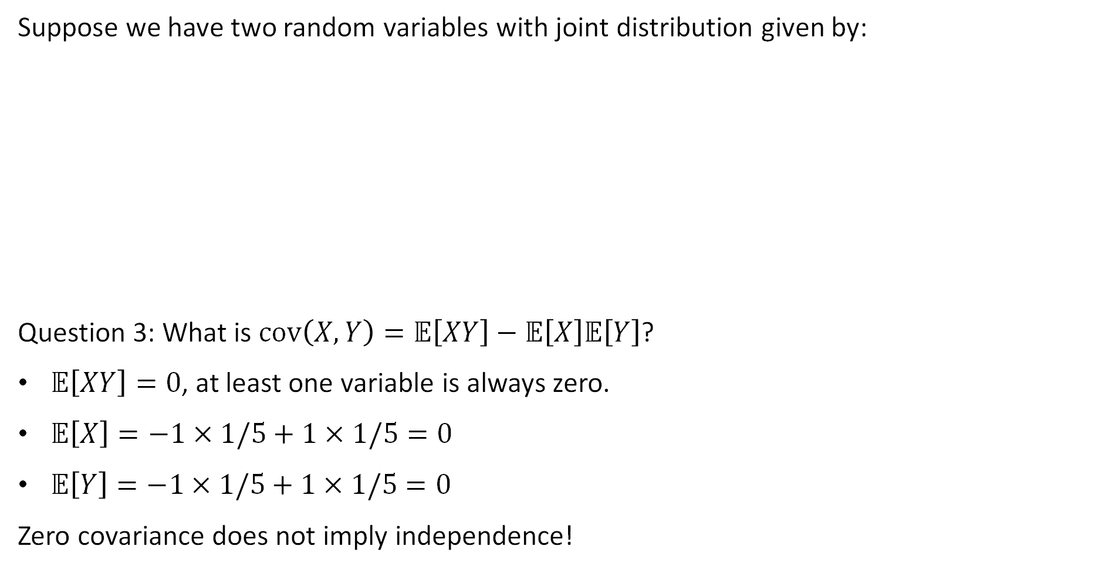
Example
Suppose we have two random variables with joint distribution given by:
Question 3: What is $cov\left(X, Y\right)=𝔼\left[XY\right]−𝔼\left[X\right]𝔼\left[Y\right]$?
$𝔼\left[XY\right]=0$, at least one variable is always zero.
$𝔼\left[X\right]=−1×1/5+1×1/5=0$
$𝔼\left[Y\right]=−1×1/5+1×1/5=0$
Zero covariance does not imply independence!
X
Y
-1
0
1
1
0 | 1/5 | 0
1/5 | 1/5 | 1/5
0 | 1/5 | 0
0
-1

Slide 24
Covariance and Independence
If two random variables are independent, their covariance is zero.
However, zero covariance can occur even with dependency.
X
Y
-1
0
1
1
0 | 1/5 | 0
1/5 | 1/5 | 1/5
0 | 1/5 | 0
0
-1

Slide 25
Standardizing Random Variables
Covariance
Definition
Relationship with Independence
Detour: Standardizing Random Variables
Property of Covariance, Correlation
Conditional Expectation
Lecture 21, CS70 Fall 2025

Slide 26

Standardizing a Random Variable
If $X$ is a random variable with mean $μ$ and stdev $σ$, then the standardized version of this random variable is given by $\tilde{X}$:
$$\tilde{X}=\frac{X−μ}{σ}$$
The standardized RV is a shifted and rescaled version of $X$ such that $𝔼\left[\tilde{X}\right]=0$ and $var\left(\tilde{X}\right)=1$.

Slide 27

Example: Standardizing Binomial(4, 0.25)
Suppose $X\sim Binomial\left(4, 0.25\right)$. We know from earlier that:
$$𝔼\left[X\right]=np=1$$
$$var\left(X\right)=np\left(1−p\right)=4×0.25×0.75=0.75$$
Then we have that $\tilde{X}$ is given by:
$$\tilde{X}=\frac{X−1}{\sqrt{0.75}}$$

Slide 28
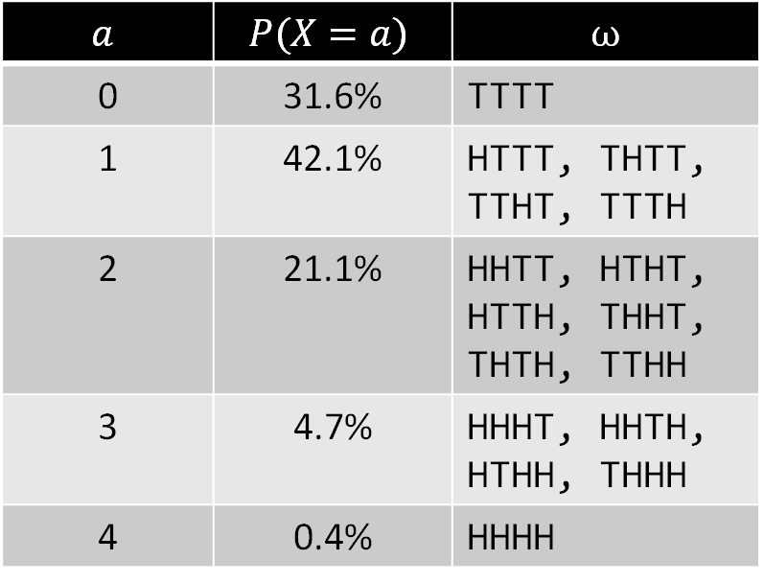

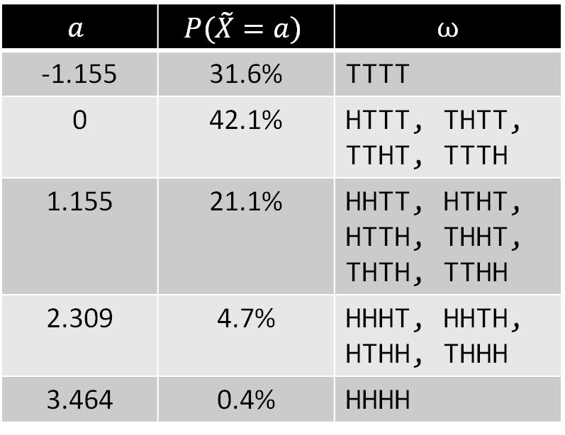
Standardized Binomial
The probabilities for a standardized random variable are exactly the same as the non-standardized version. The only difference is that the range of the RV is shifted and rescaled. Example for $X\sim Binomial\left(4, 0.25\right)$ and $\tilde{X}$ below.
Note: The values in the range of the new RV are what you may have heard called “z-scores”.
$$a$$ | $$P(X=a)$$ | $$ω$$
0 | 31.6% | TTTT
1 | 42.1% | HTTT, THTT, TTHT, TTTH
2 | 21.1% | HHTT, HTHT, HTTH, THHT, THTH, TTHH
3 | 4.7% | HHHT, HHTH, HTHH, THHH
4 | 0.4% | HHHH
$$a$$ | $$P(\tilde{X}=a)$$ | $$ω$$
-1.155 | 31.6% | TTTT
0 | 42.1% | HTTT, THTT, TTHT, TTTH
1.155 | 21.1% | HHTT, HTHT, HTTH, THHT, THTH, TTHH
2.309 | 4.7% | HHHT, HHTH, HTHH, THHH
3.464 | 0.4% | HHHH

Slide 29
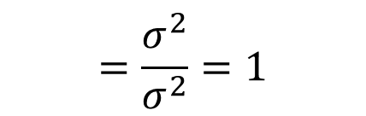
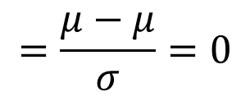
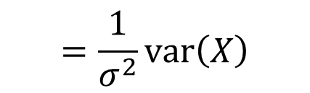
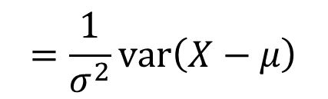

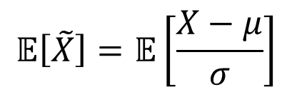
Standardized RV Expectation and Variance
If $X$ is a random variable with mean $μ$ and stdev $σ$, and $\tilde{X}=\frac{X−μ}{σ}$, then:
$$𝔼\left[\tilde{X}\right]=𝔼\left[\frac{X−μ}{σ}\right]$$
$$=\frac{μ−μ}{σ}=0$$
$$var\left(\tilde{X}\right)=var\left(\frac{X−μ}{σ}\right)$$
$$=\frac{1}{σ^{2}}var\left(X−μ\right)$$
$$=\frac{1}{σ^{2}}var\left(X\right)$$
$$=\frac{σ^{2}}{σ^{2}}=1$$

Slide 30


Another Useful Property of Standardized Random Variables
If $X$ is a random variable with mean $μ$ and stdev $σ$, and $\tilde{X}=\frac{X−μ}{σ}$, what is $𝔼\left[{\tilde{X}}^{2}\right]$?
Note: We just showed that:
$𝔼\left[\tilde{X}\right]=0$
$var\left(\tilde{X}\right)=1$
Answer at joshh.ug/D
https://joshh.ug/D

Slide 31



Another Useful Property of Standardized Random Variables
If $X$ is a random variable with mean $μ$ and stdev $σ$, and $\tilde{X}=\frac{X−μ}{σ}$, what is $𝔼\left[{\tilde{X}}^{2}\right]$?
Observation: Since $𝔼\left[\tilde{X}\right]=0$, $var\left(\tilde{X}\right)=𝔼\left[{\tilde{X}}^{2}\right]$. This is because:
Since $var\left(\tilde{X}\right)=𝔼\left[{\tilde{X}}^{2}\right]$, this means $𝔼\left[{\tilde{X}}^{2}\right]=1$.
$$var\left(\tilde{X}\right)=𝔼\left[{\tilde{X}}^{2}\right]−𝔼{\left[\tilde{X}\right]}^{2}$$
$$=𝔼\left[{\tilde{X}}^{2}\right]$$

Slide 32
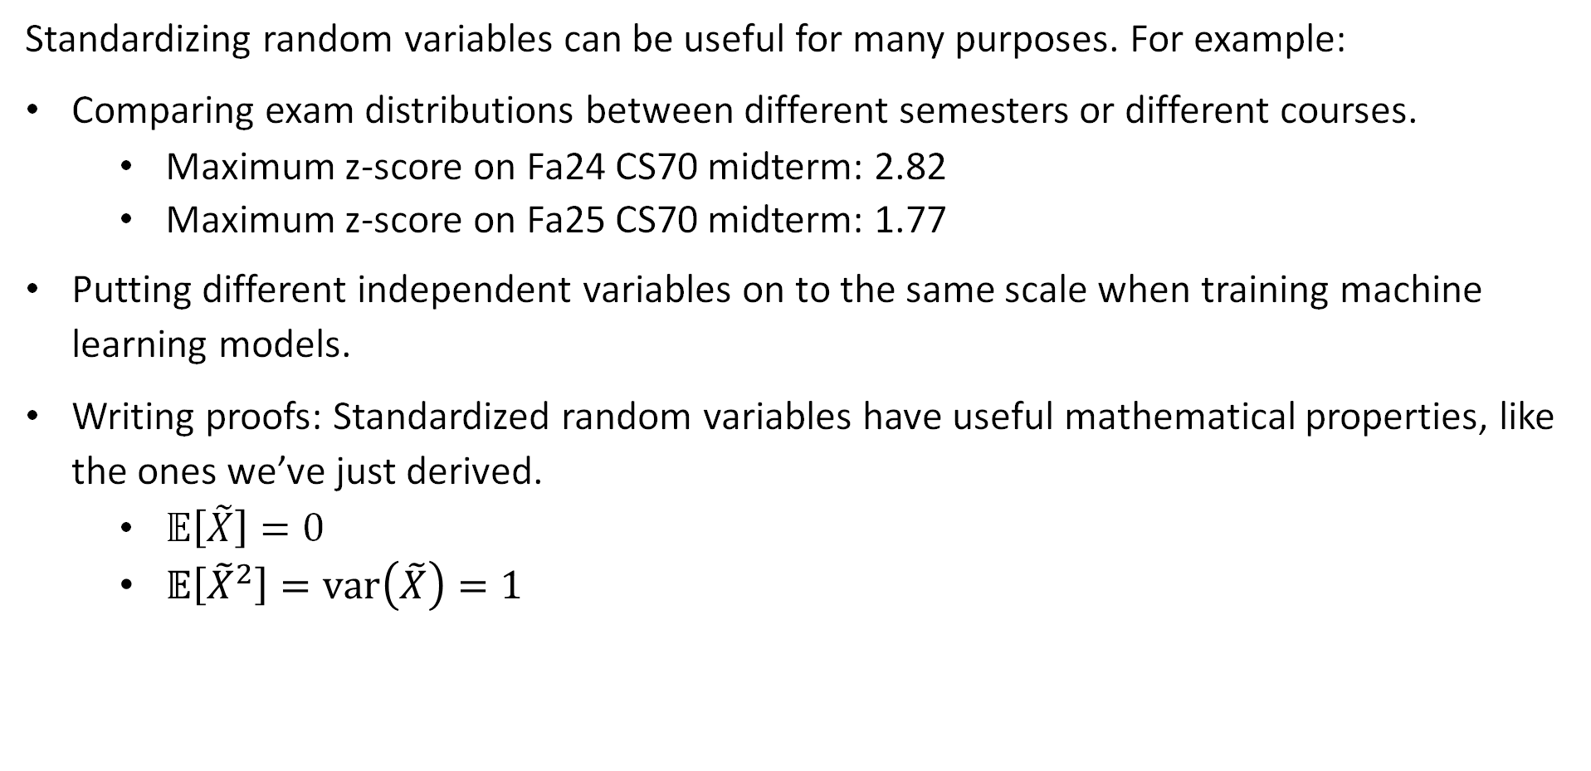
Use of Standardized Random Variables
Standardizing random variables can be useful for many purposes. For example:
Comparing exam distributions between different semesters or different courses.
  Maximum z-score on Fa24 CS70 midterm: 2.82
  Maximum z-score on Fa25 CS70 midterm: 1.77
Putting different independent variables on to the same scale when training machine learning models.
Writing proofs: Standardized random variables have useful mathematical properties, like the ones we’ve just derived.
  $𝔼\left[\tilde{X}\right]=0$
  $𝔼\left[{\tilde{X}}^{2}\right]=var\left(\tilde{X}\right)=1$

Slide 33
Properties of Covariance, Correlation
Covariance
Definition
Relationship with Independence
Detour: Standardizing Random Variables
Property of Covariance, Correlation
Conditional Expectation
Lecture 21, CS70 Fall 2025

Slide 34
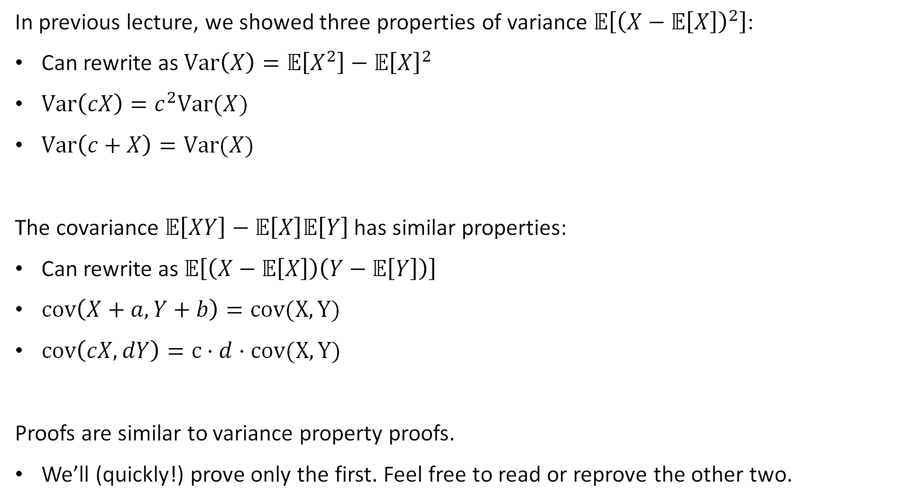
Variance
In previous lecture, we showed three properties of variance $𝔼\left[{\left(X−𝔼\left[X\right]\right)}^{2}\right]$:
Can rewrite as $Var\left(X\right)=𝔼\left[X^{2}\right]−𝔼{\left[X\right]}^{2}$
$Var\left(cX\right)=c^{2}Var(X)$
$Var\left(c+X\right)=Var(X)$
The covariance $𝔼\left[XY\right]−𝔼\left[X\right]𝔼\left[Y\right]$has similar properties:
Can rewrite as $𝔼\left[\left(X−𝔼\left[X\right]\right)\left(Y−𝔼\left[Y\right]\right)\right]$
$cov\left(X+a, Y+b\right)=cov(X,Y)$
$cov\left(cX, dY\right)=c⋅d⋅cov(X,Y)$
Proofs are similar to variance property proofs.
We’ll (quickly!) prove only the first. Feel free to read or reprove the other two.

Slide 35

Extra Slide: Proof of First Useful Property
$cov\left(X, Y\right)=𝔼\left[XY\right]−𝔼\left[X\right]𝔼\left[Y\right]$:
Can also be written as $𝔼\left[\left(X−𝔼\left[X\right]\right)\left(Y−𝔼\left[Y\right]\right)\right]$
Proof: For conciseness of notation, let $μ_{x}=𝔼\left[X\right]$ and $μ_{y}=𝔼\left[Y\right]$.
$$𝔼\left[\left(X−𝔼\left[X\right]\right)\left(Y−𝔼\left[Y\right]\right)\right]$$
$$=𝔼\left[\left(X−μ_{X}\right)\left(Y−μ_{y}\right)\right]$$
$$=𝔼\left[XY−μ_{Y}X−μ_{X}Y+μ_{X}μ_{Y}\right]$$
$$=𝔼\left[XY\right]−μ_{Y}𝔼\left[X\right]−μ_{X}𝔼\left[Y\right]+μ_{X}μ_{Y}$$
$$=𝔼\left[XY\right]−μ_{X}μ_{Y}−μ_{X}μ_{Y}+μ_{X}μ_{Y}$$
$$=𝔼\left[XY\right]−μ_{X}μ_{Y}$$

Slide 36
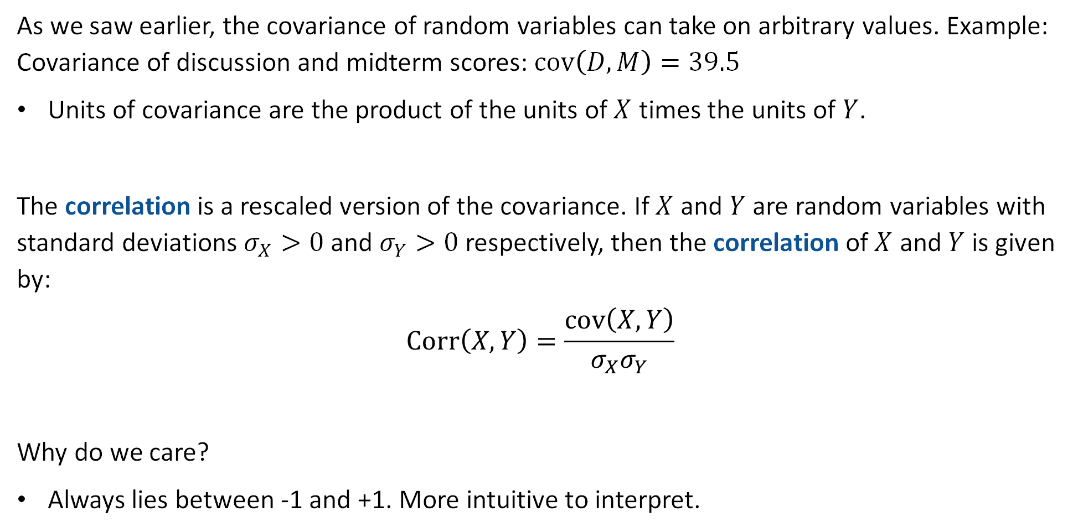
Correlation
As we saw earlier, the covariance of random variables can take on arbitrary values. Example: Covariance of discussion and midterm scores: $cov\left(D,M\right)=39.5$
Units of covariance are the product of the units of $X$ times the units of $Y$.
The correlation is a rescaled version of the covariance. If $X$ and $Y$ are random variables with standard deviations $σ_{X}>0$ and $σ_{Y}>0$ respectively, then the correlation of $X$ and $Y$ is given by:
$$Corr\left(X,Y\right)=\frac{cov\left(X,Y\right)}{σ_{X}σ_{Y}}$$
Why do we care?
Always lies between -1 and +1. More intuitive to interpret.

Slide 37
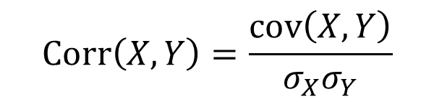

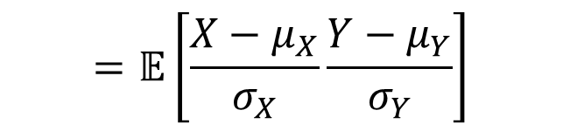
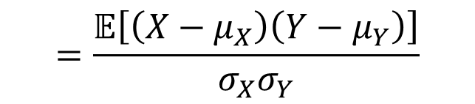
Proof of Correlation Range
Claim: The correlation is always between -1 and 1.
$$−1≤Corr\left(X,Y\right)=\frac{cov\left(X,Y\right)}{σ_{X}σ_{Y}}≤+1$$
Lemma: Let $𝔼\left[X\right]=μ_{X}$, $𝔼\left[Y\right]=μ_{Y}$. Let $\tilde{X}$ and $\tilde{Y}$ be the standardized versions of $X$ and $Y$. Then $Corr\left(X,Y\right)=𝔼\left[\tilde{X}\tilde{Y}\right]$
Proof of Lemma:
$$Corr\left(X,Y\right)=\frac{cov\left(X,Y\right)}{σ_{X}σ_{Y}}$$
$$=\frac{𝔼\left[\left(X−μ_{X}\right)\left(Y−μ_{Y}\right)\right]}{σ_{X}σ_{Y}}$$
$$=𝔼\left[\frac{X−μ_{X}}{σ_{X}}\frac{Y−μ_{Y}}{σ_{Y}}\right]$$
$$=𝔼\left[\tilde{X}\tilde{Y}\right]$$

Slide 38




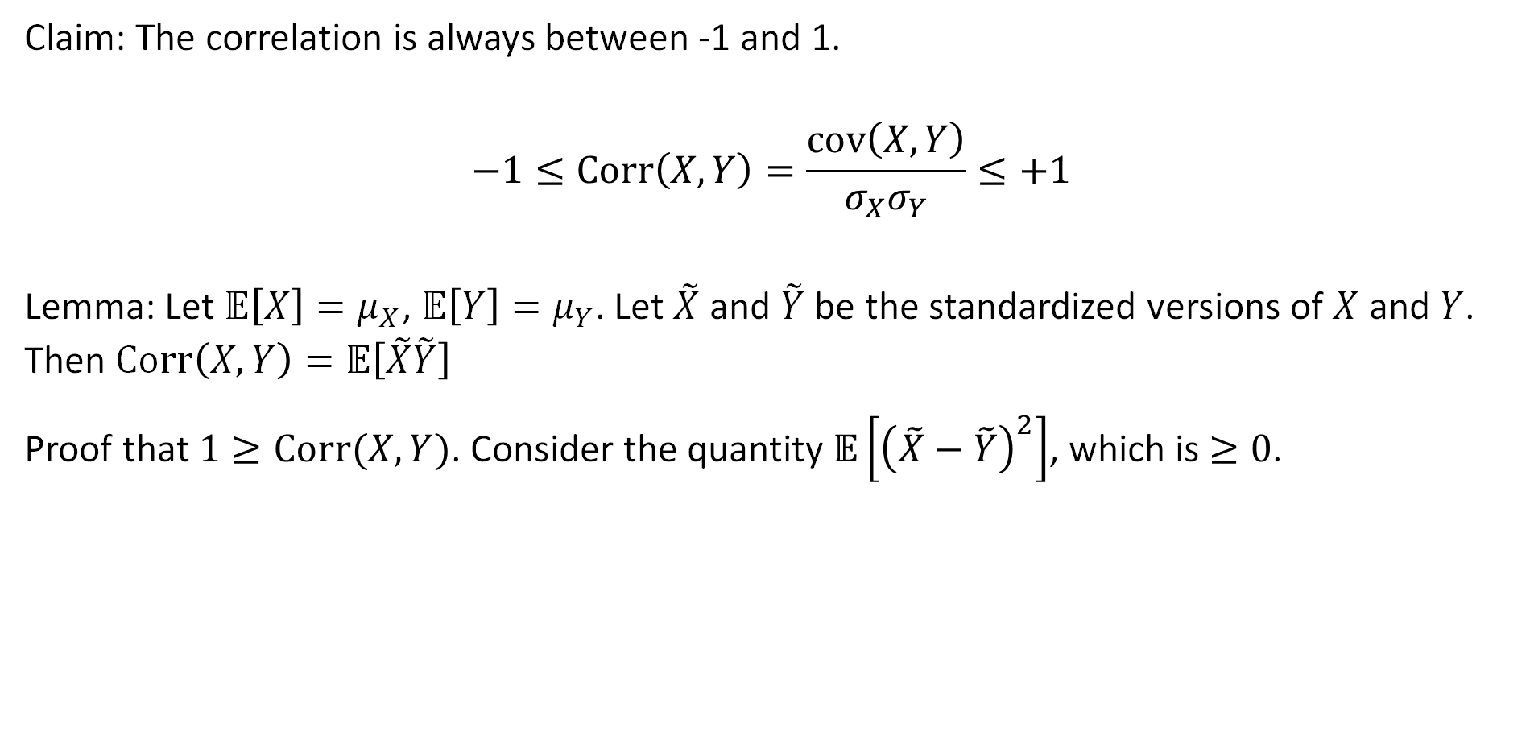

Proof of Correlation Range
Claim: The correlation is always between -1 and 1.
$$−1≤Corr\left(X,Y\right)=\frac{cov\left(X,Y\right)}{σ_{X}σ_{Y}}≤+1$$
Lemma: Let $𝔼\left[X\right]=μ_{X}$, $𝔼\left[Y\right]=μ_{Y}$. Let $\tilde{X}$ and $\tilde{Y}$ be the standardized versions of $X$ and $Y$. Then $Corr\left(X,Y\right)=𝔼\left[\tilde{X}\tilde{Y}\right]$
Proof that $1≥Corr(X,Y)$. Consider the quantity $𝔼\left[{\left(\tilde{X}−\tilde{Y}\right)}^{2}\right]$, which is $≥0$.
$$𝔼\left[{\left(\tilde{X}−\tilde{Y}\right)}^{2}\right]$$
$$=𝔼\left[{\tilde{X}}^{2}\right]−2𝔼\left[\tilde{X}\tilde{Y}\right]+𝔼\left[{\tilde{Y}}^{2}\right]$$
$$=1−2𝔼\left[\tilde{X}\tilde{Y}\right]+1$$
$$=2−2Corr(X, Y)$$
Thus, $2−2Corr\left(X, Y\right)≥0$
So: $1≥Corr\left(X, Y\right)$

Slide 39



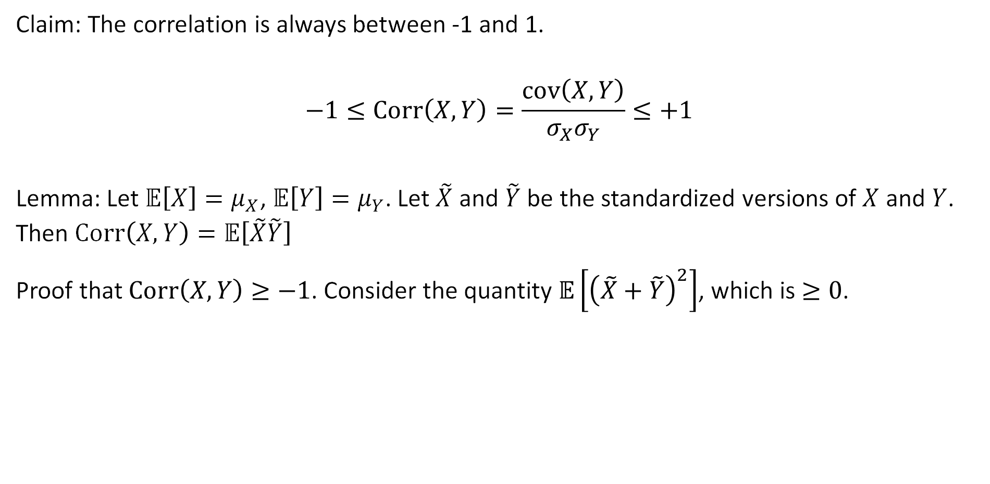

Proof of Correlation Range
Claim: The correlation is always between -1 and 1.
$$−1≤Corr\left(X,Y\right)=\frac{cov\left(X,Y\right)}{σ_{X}σ_{Y}}≤+1$$
Lemma: Let $𝔼\left[X\right]=μ_{X}$, $𝔼\left[Y\right]=μ_{Y}$. Let $\tilde{X}$ and $\tilde{Y}$ be the standardized versions of $X$ and $Y$. Then $Corr\left(X,Y\right)=𝔼\left[\tilde{X}\tilde{Y}\right]$
Proof that $Corr\left(X,Y\right)≥−1$. Consider the quantity $𝔼\left[{\left(\tilde{X}+\tilde{Y}\right)}^{2}\right]$, which is $≥0$.
$$𝔼\left[{\left(\tilde{X}+\tilde{Y}\right)}^{2}\right]$$
$$=𝔼\left[{\tilde{X}}^{2}\right]+2𝔼\left[\tilde{X}\tilde{Y}\right]+𝔼\left[{\tilde{Y}}^{2}\right]$$
$$=1+2𝔼\left[\tilde{X}\tilde{Y}\right]+1$$
$$=2+2Corr(X, Y)$$
Thus, $2+2Corr\left(X, Y\right)≥0$
So: $Corr\left(X, Y\right)≥−1$

Slide 40
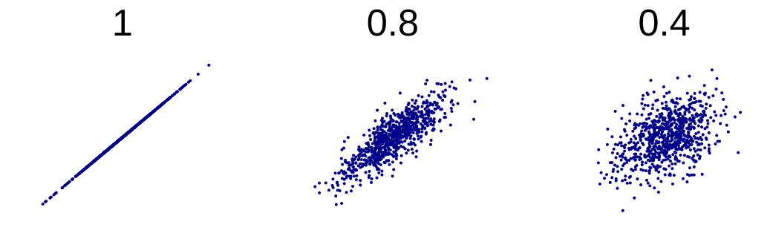
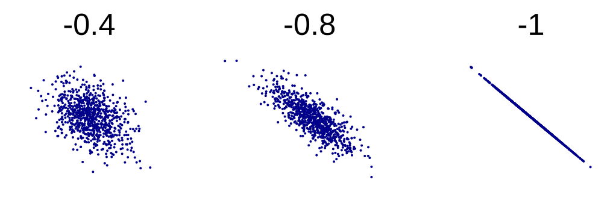

Correlation Examples
Examples of positive correlated random variables, $Corr\left(X, Y\right)>0$:
Examples of negative correlated random variables, $Corr\left(X, Y\right)<0$:

Slide 41
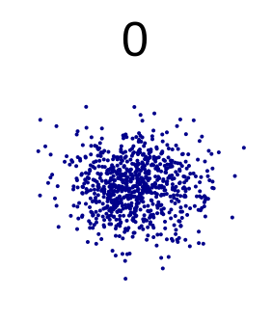


Correlation Of Zero
Examples of independent RV with $Corr\left(X, Y\right)=0$:
Example of dependent RV with $Corr\left(X, Y\right)=0$. Why are these not independent?

Slide 42

Correlation Of Discussion and Midterm Scores
We can compute the correlation of midterm and discussion scores as:
On our actual data this semester, this correlation is 0.33.
$$corr\left(D, M\right)=\frac{𝔼\left[DM\right]−𝔼\left[D\right]𝔼\left[M\right]}{σ_{D}σ_{M}}$$
Fall 24 it was 0.32
$$a$$ | $$P\left(D=a\right)$$
0 | 11/514
1 | 5/514
2 | 3/514
3 | 4/514
4 | 7/514
5 | 5/514
6 | 9/514
7 | 18/514
… | …
$$a$$ | $$P\left(M=a\right)$$
…
51.0 | 1/514
52.0 | 3/514
52.5 | 2/514
53.0 | 1/514
53.5 | 1/514
…
158.0 | 2/514
159.0 | 1/514
((mt*dis).mean() - mt.mean() * dis.mean()) / (mid.std()*dis.std())

Slide 43

Scatter Plot (Beyond Scope of Course)
If we scatterplot midterm vs. discussion score, we get the plot below.
Can kind of see an upward relationship, though the “overplotting” makes this tricky since overlapping points obscure each other.

Slide 44

Scatter Plot (Beyond Scope of Course)
Can see the upward relationship a bit better if we overlay the average midterm score per possible discussion value.
Example: Average midterm score of the 5 students who attended exactly 3 discussions is 87.5.
87.5

Slide 45

Note on Unity Correlation
Suppose $Corr\left(X, Y\right)=1$. In that case, we have that $\tilde{X}=$ $\tilde{Y}$. Why?
Because $𝔼\left[{\left(\tilde{X}−\tilde{Y}\right)}^{2}\right]=2−2Corr(X, Y)$
If $Corr\left(X, Y\right)=1$, then $𝔼\left[{\left(\tilde{X}−\tilde{Y}\right)}^{2}\right]=0$, so $\tilde{X}=\tilde{Y}$
Implication: if $Corr\left(X, Y\right)=1$, then random variables $X$ and $Y$ are just rescaled and shifted versions of each other, i.e. there exist $a>0$ and $b$ such that:
$$Y=aX+b$$
Can show a similar result if $Corr\left(X,Y\right)=−1$, in which case $a<0$.

Slide 46
Conditional Expectation
Covariance
Definition
Relationship with Independence
Detour: Standardizing Random Variables
Correlation
Property of Covariance, Correlation
Conditional Expectation
Lecture 21, CS70 Fall 2025

Slide 47


Conditional Expectation
Consider the following jointly distributed random variables X and Y:
Y is the outcome of a 20 sided die roll.
X is the outcome of a y-sided die roll, where y is the result of the 20-sided die roll.
Question 1: What is $𝔼\left[X|Y=6\right]$?
This is just the expectation of a six-sided die, i.e.
Or equivalently:
$$𝔼\left[X|Y=6\right]=1⋅\frac{1}{6}+2⋅\frac{1}{6}+…+6⋅\frac{1}{6}=\frac{1+2+3+4+5+6}{6}=3.5$$
$$𝔼\left[X|Y=6\right]=\sum_{x∈range(X)}{x⋅P\left(X=x | Y=6\right)=3.5}$$
We can generalize this to any jointly distributed RVs.

Slide 48


Conditional Expectation
Suppose we have two jointly distributed random variables $X$ and $Y$. We can define the “conditional expectation of X given Y = y” as:
For the example of our two dependent dice rolls where the first roll was $6$, we had:
$$𝔼\left[X|Y=y\right]=\sum_{x∈range(X)}{x⋅P\left(X=x | Y=y\right)}$$
$$𝔼\left[X|Y=6\right]=\sum_{x∈range(X)}{x⋅P\left(X=x | Y=6\right)=3.5}$$

Slide 49


Conditional Expectation
For the example of our two dependent dice rolls where the first roll was $6$, we had:
More generally, suppose we have two jointly distributed random variables $X$ and $Y$. Then we can define the “conditional expectation of X given Y = y” as:
$$𝔼\left[X|Y=6\right]=\sum_{x∈range(X)}{x⋅P\left(X=x | Y=6\right)=3.5}$$
$$𝔼\left[X|Y=y\right]=\sum_{x∈range(X)}{x⋅P\left(X=x | Y=y\right)}$$

Slide 50

The Law of Total Expectation
Consider the following jointly distributed random variables X and Y:
Y is the outcome of a 20 sided die roll.
X is the outcome of a y-sided die roll, where y is the result of the 20-sided die roll.
Question 2: How would we find $𝔼\left[X\right]$?

Slide 51

The Law of Total Expectation
Consider the following jointly distributed random variables X and Y:
Y is the outcome of a 20 sided die roll.
X is the outcome of a y-sided die roll, where y is the result of the 20-sided die roll.
Question 2: How would we find $𝔼\left[X\right]$?
Consider all possibilities for y, compute conditional expectation of X for each y:
  If $Y=1$, then $𝔼\left[X|Y=1\right]=\left(1+1\right)/2=1$
  If $Y=2$, then $𝔼\left[X | Y=2\right]=\left(1+2\right)/2=1.5$
  …
  If $Y=20$, then $𝔼\left[X | Y=20\right]=\left(1+20\right)/2=10.5$
Each of these 20 possibilities is equally likely, so:
  $$𝔼\left[X\right]=1⋅\frac{1}{20}+1.5⋅\frac{1}{20}+…+10.5⋅\frac{1}{20}$$

Slide 52


The Law of Total Expectation
Consider the following jointly distributed random variables X and Y:
Y is the outcome of a 20 sided die roll.
X is the outcome of a y-sided die roll, where y is the result of the 20-sided die roll.
Question 2: How would we find $𝔼\left[X\right]$?
  $$𝔼\left[X\right]=1⋅\frac{1}{20}+1.5⋅\frac{1}{20}+…+10.5⋅\frac{1}{20}$$
  $$=\frac{115}{20}=5.75$$

Slide 53





The Law of Total Expectation
For our dependent die rolls, how would we find $𝔼\left[X\right]$?
Consider all possibilities for y, compute conditional expectation of X for each y.
Compute weighted sum of those individual expectations:
  $$𝔼\left[X\right]=1⋅\frac{1}{20}+1.5⋅\frac{1}{20}+…+10.5⋅\frac{1}{20}$$
More generally, we have the law of total expectation:
$$𝔼\left[X\right]=\sum_{i=1}^{n}{𝔼\left[X|A_{i}\right]⋅P\left(A_{i}\right)}$$
$$𝔼\left[X|Y=1\right]$$
$$P(Y=1)$$
$$𝔼\left[X|Y=20\right]$$
$$P(Y=20)$$

Slide 54



The Law of Total Expectation
For our dependent die rolls, how would we find $𝔼\left[X\right]$?
Consider all possibilities for y, compute conditional expectation of X for each y.
Compute weighted sum of those individual expectations:
  $$𝔼\left[X\right]=1⋅\frac{1}{20}+1.5⋅\frac{1}{20}+…+10.5⋅\frac{1}{20}$$
More generally, we have the law of total expectation:
$$𝔼\left[X\right]=\sum_{i=1}^{n}{𝔼\left[X|A_{i}\right]⋅P\left(A_{i}\right)}$$
What is $Y=20$?
$$𝔼\left[X|Y=1\right]$$
$$P(Y=1)$$
$$𝔼\left[X|Y=20\right]$$
$$P(Y=20)$$
https://joshh.ug/E

Slide 55

The Law of Total Expectation
For our dependent die rolls, how would we find $𝔼\left[X\right]$?
Consider all possibilities for y, compute conditional expectation of X for each y.
Compute weighted sum of those individual expectations:
  $$𝔼\left[X\right]=1⋅\frac{1}{20}+1.5⋅\frac{1}{20}+…+10.5⋅\frac{1}{20}$$
More generally, we have the law of total expectation:
$$𝔼\left[X\right]=\sum_{i=1}^{n}{𝔼\left[X|A_{i}\right]⋅P\left(A_{i}\right)}$$
What is $Y=20$?
The set of all sample points in the sample space which Y maps to 20.
An event.
A subset of the sample space.
$$𝔼\left[X|Y=1\right]$$
$$P(Y=1)$$
$$𝔼\left[X|Y=20\right]$$
$$P(Y=20)$$

Slide 56


The Law of Total Expectation
More generally, we have the law of total expectation:
$$𝔼\left[X\right]=\sum_{i=1}^{n}{𝔼\left[X|A_{i}\right]⋅P\left(A_{i}\right)}$$
In the context of our die rolling example, our events are defined by the random variable Y.
$A_{1}$ is the event that $Y=1$, $A_{2}$ is the event that $Y=2$, etc.
Can rewrite as:
$$𝔼\left[X\right]=\sum_{y∈range(Y)}{𝔼\left[X|Y=y\right]⋅P\left(Y=y\right)}$$

Slide 57


Iterated Expectation
For jointly distributed RVs $X$ and $Y$, the Law of Total Expectation gives us:
A more concise version of the equation above is simply the iterated expectation:
We’ll prove this first in a moment.
Let’s first see why this more compact iterated expectation formula is so useful.
$$𝔼\left[X\right]=\sum_{y∈range(Y)}{𝔼\left[X|Y=y\right]⋅P\left(Y=y\right)}$$
$$𝔼\left[X\right]=𝔼\left[𝔼\left[X | Y\right]\right]$$

Slide 58

Iterated Expectation
Consider the following jointly distributed random variables X and Y:
Y is the outcome of a 20 sided die roll.
X is the outcome of a y-sided die roll, where y is the result of the 20-sided die roll.
We know that $𝔼\left[X\right]=𝔼\left[𝔼\left[X | Y\right]\right]$
First we need to identify $𝔼\left[X | Y\right]$. What is it?

Slide 59

Iterated Expectation
Consider the following jointly distributed random variables X and Y:
Y is the outcome of a 20 sided die roll.
X is the outcome of a y-sided die roll, where y is the result of the 20-sided die roll.
We know that $𝔼\left[X\right]=𝔼\left[𝔼\left[X | Y\right]\right]$
First we need to identify $𝔼\left[X | Y\right]$. What is it?
$𝔼\left[X | Y\right]$ is a random variable. Its distribution is?

Slide 60
Iterated Expectation
Consider the following jointly distributed random variables X and Y:
Y is the outcome of a 20 sided die roll.
X is the outcome of a y-sided die roll, where y is the result of the 20-sided die roll.
We know that $𝔼\left[X\right]=𝔼\left[𝔼\left[X | Y\right]\right]$
First we need to identify $𝔼\left[X | Y\right]$. What is it?
$𝔼\left[X | Y\right]$ is a random variable. Its distribution is?

Slide 61


Iterated Expectation
Consider the following jointly distributed random variables X and Y:
Y is the outcome of a 20 sided die roll.
X is the outcome of a y-sided die roll, where y is the result of the 20-sided die roll.
We know that $𝔼\left[X\right]=𝔼\left[𝔼\left[X | Y\right]\right]$
First we need to identify $𝔼\left[X | Y\right]$. What is it?
$𝔼\left[X | Y\right]$ is a random variable. Its distribution is:
$$h$$ | $$P\left(𝔼\left[X | Y\right]=h\right)$$
1 | 1/20
1.5 | 1/20
2 | 1/20
2.5 | 1/20
3 | 1/20
3.5 | 1/20
…
10 | 1/20
10.5 | 1/20

Slide 62

Iterated Expectation
Consider the following jointly distributed random variables X and Y:
Y is the outcome of a 20 sided die roll.
X is the outcome of a y-sided die roll, where y is the result of the 20-sided die roll.
We know that $𝔼\left[X\right]=𝔼\left[𝔼\left[X | Y\right]\right]$
First we need to identify $𝔼\left[X | Y\right]$. What is it?
$𝔼\left[X | Y\right]$ is a random variable. Its distribution is:
How can we write $𝔼\left[X | Y\right]$ in terms of $Y$?
$$h$$ | $$P\left(𝔼\left[X | Y\right]=h\right)$$
1 | 1/20
1.5 | 1/20
2 | 1/20
2.5 | 1/20
3 | 1/20
3.5 | 1/20
…
10 | 1/20
10.5 | 1/20

Slide 63


Iterated Expectation
Consider the following jointly distributed random variables X and Y:
Y is the outcome of a 20 sided die roll.
X is the outcome of a y-sided die roll, where y is the result of the 20-sided die roll.
We know that $𝔼\left[X\right]=𝔼\left[𝔼\left[X | Y\right]\right]$
First we need to identify $𝔼\left[X | Y\right]$. What is it?
$𝔼\left[X | Y\right]$ is a random variable. Its distribution is:
How can we write $𝔼\left[X | Y\right]$ in terms of $Y$?
  $𝔼\left[X | Y\right]=\frac{Y+1}{2}$
$$h$$ | $$P\left(𝔼\left[X | Y\right]=h\right)$$
1 | 1/20
1.5 | 1/20
2 | 1/20
2.5 | 1/20
3 | 1/20
3.5 | 1/20
…
10 | 1/20
10.5 | 1/20
$$y$$ | $$P\left(Y=y\right)$$
1 | 1/20
2 | 1/20
3 | 1/20
4 | 1/20
5 | 1/20
6 | 1/20
…
19 | 1/20
20 | 1/20

Slide 64

Iterated Expectation
Consider the following jointly distributed random variables X and Y:
Y is the outcome of a 20 sided die roll.
X is the outcome of a y-sided die roll, where y is the result of the 20-sided die roll.
We know that $𝔼\left[X\right]=𝔼\left[𝔼\left[X | Y\right]\right]$
First we need to identify $𝔼\left[X | Y\right]$. What is it?
$𝔼\left[X | Y\right]$ is a random variable. Its distribution is:
How can we write $𝔼\left[X | Y\right]$ in terms of $Y$?
  $𝔼\left[X | Y\right]=\frac{Y+1}{2}$
So what is $𝔼\left[X\right]$?
$$h$$ | $$P\left(𝔼\left[X | Y\right]=h\right)$$
1 | 1/20
1.5 | 1/20
2 | 1/20
2.5 | 1/20
3 | 1/20
3.5 | 1/20
…
10 | 1/20
10.5 | 1/20
$$y$$ | $$P\left(Y=y\right)$$
1 | 1/20
2 | 1/20
3 | 1/20
4 | 1/20
5 | 1/20
6 | 1/20
…
19 | 1/20
20 | 1/20

Slide 65

Iterated Expectation
Consider the following jointly distributed random variables X and Y:
Y is the outcome of a 20 sided die roll.
X is the outcome of a y-sided die roll, where y is the result of the 20-sided die roll.
We know that $𝔼\left[X\right]=𝔼\left[𝔼\left[X | Y\right]\right]$
First we need to identify $𝔼\left[X | Y\right]$. What is it?
$𝔼\left[X | Y\right]$ is a random variable. Its distribution is:
How can we write $𝔼\left[X | Y\right]$ in terms of $Y$?
  $𝔼\left[X | Y\right]=\frac{Y+1}{2}$
$𝔼\left[X\right]=𝔼\left[\frac{Y+1}{2}\right]=\frac{𝔼\left[Y\right]+1}{2}=\frac{10.5+1}{2}=5.75$
$$h$$ | $$P\left(𝔼\left[X | Y\right]=h\right)$$
1 | 1/20
1.5 | 1/20
2 | 1/20
2.5 | 1/20
3 | 1/20
3.5 | 1/20
…
10 | 1/20
10.5 | 1/20
$$y$$ | $$P\left(Y=y\right)$$
1 | 1/20
2 | 1/20
3 | 1/20
4 | 1/20
5 | 1/20
6 | 1/20
…
19 | 1/20
20 | 1/20

Slide 66




Comparing Our Two Approaches
Our first approach was to apply the law of total expectation:
Our second approach was to use iterated expectation:
Now we just need to know that $\sum_{y∈range(Y)}{𝔼\left[X|Y=y\right]⋅P\left(Y=y\right)}=𝔼\left[𝔼\left[X | Y\right]\right]$
$$𝔼\left[X\right]=\sum_{y∈range(Y)}{𝔼\left[X|Y=y\right]⋅P\left(Y=y\right)}$$
$$=1⋅\frac{1}{20}+1.5⋅\frac{1}{20}+…+10.5⋅\frac{1}{20}$$
$$𝔼\left[X\right]=𝔼\left[𝔼\left[X | Y\right]\right]$$
$$=𝔼\left[\frac{Y+1}{2 }\right]=\frac{𝔼\left[Y\right]+1}{2}=\frac{10.5+1}{2}=5.75$$

Slide 67


Recall: The Law of the Unconscious Statistician
Let us recall the Law of the Unconscious Statistician (LOTUS).
Suppose we have a random variable $X$ and we define a new random variable $Q=f\left(X\right)$. Then we have that:
$$𝔼\left[Q\right]=𝔼\left[f\left(X\right)\right]=\sum_{x∈range(X)}{f\left(x\right)P\left(X=x\right)}$$
Example: If $X\sim Binomial\left(50,0.3\right)$, and $Q=cos⁡(X)$ then
$$𝔼\left[Q\right]=\sum_{x=0}^{50}{cos⁡(x)P\left(X=x\right)}=\sum_{x=0}^{50}{\cos\left(x\right)\left({50 \atop x}\right)}{0.3}^{x}{0.7}^{50−x}$$

Slide 68




Proof of the Iterated Expectation Formula
$$𝔼\left[X\right]=\sum_{y∈range(Y)}{𝔼\left[X|Y=y\right]⋅P\left(Y=y\right)}$$
We already know that
We observe that we can rewrite this as
where we define $f\left(y\right)=𝔼\left[X|Y=y\right]$
  Given a specific number, $f$ returns $𝔼\left[X|Y=y\right]$.
  For our dice example: $f\left(y\right)=\frac{y+1}{2}$
Therefore $𝔼\left[X|Y\right]=f\left(Y\right)$
Using the law of the unconscious statistician, we know that:
$$𝔼\left[X\right]=\sum_{y∈range(Y)}{f\left(y\right)⋅P\left(Y=y\right)}$$
$$𝔼\left[X\right]=\sum_{y∈range(Y)}{f\left(y\right)⋅P\left(Y=y\right)}=𝔼\left[f\left(Y\right)\right]=𝔼\left[𝔼\left[X|Y\right]\right]$$

Slide 69

Summary
$cov\left(X, Y\right)=𝔼\left[XY\right]−𝔼\left[X\right]𝔼\left[Y\right]$
$Var\left(X+Y\right)=Var\left(X\right)+Var\left(Y\right)+2cov(X,Y)$
If $X$ and $Y$ are independent, then $cov\left(X,Y\right)=0$. The converse is not true.
Covariance is in units of X times units of Y.
Standardized random variables have mean 0 and variance 1.
Correlation is always between -1 and 1.
The law of total expectation lets us compute the conditional expectation of a random variable $X$ in terms of the expectation across various conditions which partition the sample space.
  If the conditions which partition the sample space come from a jointly distributed random variable $Y$, we can use the iterated expectation form.

